Slide 1

Vrinda Store Data analysis
Excel Project

Slide 2
objective
Vrinda store wants to create an annual sales report for 2022. So that, Vrinda can understand their customers and grow more sales in 2023.

Slide 3
questions
Compare the sales and orders using single chart
Which month got the highest sales and orders?
Who purchased more- men or women in 2022?
What are different order status in 2022?
List top 10 states contributing to the sales?
Relation between age and gender based on numbers
Which channel is contributing to maximum sales?
Highest selling category?, etc..

Slide 4
steps
1.Data Cleaning
2. Data Processing
3. Data Analysis

Slide 5
insights

Slide 6
Sample insights
Women are more likely to buy compared to men (~65%)
Maharsthra, Karnataka and Uttar Pradesh are the top 3 states(~35%)
Adult age group (30-49yrs) is max contributing(~50%)
Amazon, Flipkart and Myntra channels are max contributing(~80%)
Final conclusion:
-Target women customers of age group (30-49yrs) living in Maharashtra, Karnataka and Uttarpradesh by showing ads/offers/coupons available on amazon , Flipkart and Myntra.

Slide 7
Project - 2
Road Accident Dashboard

Slide 8
requirement
[Clients wants to create a Road Accident Dashboard for year 2021 and 2022 so that they can have insights on the below requirements]
- Primary KPI - Total Casualties taken place after the accident
Primary KPI's - Total Casualties & percentage of total with respect to accident severity and maximum casualties by type of vehicle.
Secondary KPI's - Total Casualties with respect to vehicle type
Monthly trend showing comparison of casualties for Current Year and Previous Year
Maximum casualties by Road Type
Distribution of total casualties by Road Surface
Relation between Casualties by Area/ Location & by Day/ Night

Slide 9
Meta data
File extension : .xlsx
No of rows : 3.07 Million
No of Fields : 21

Slide 10
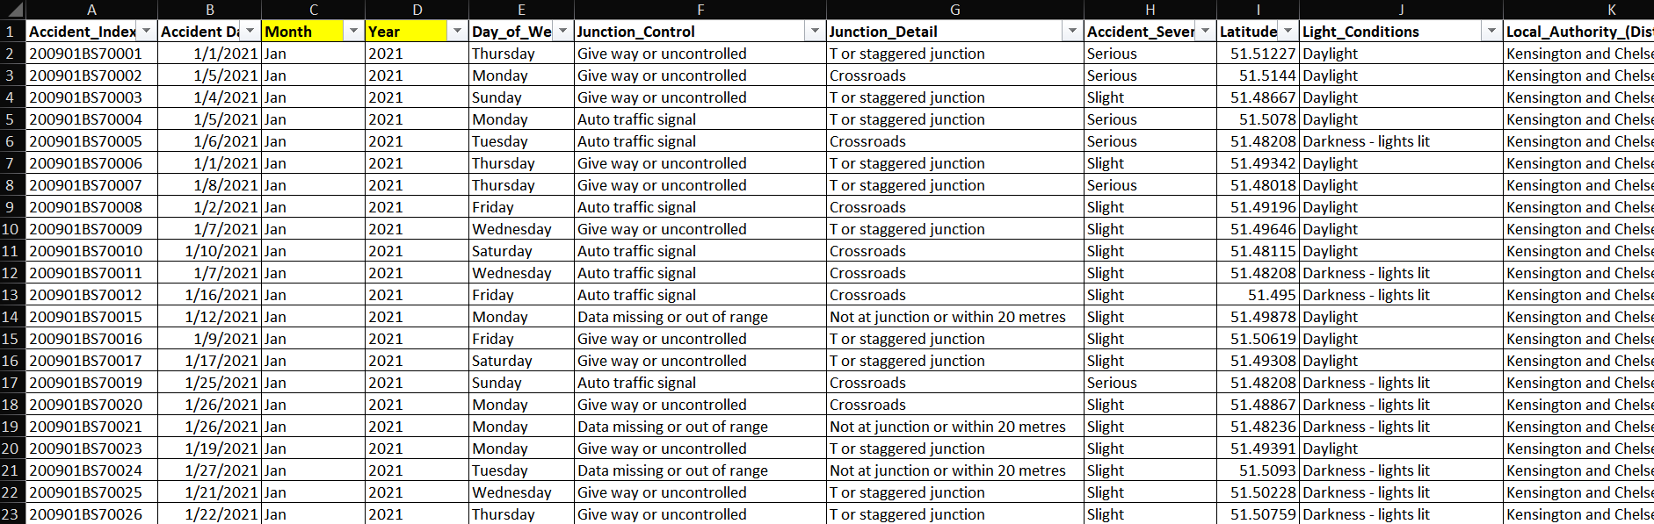
Data cleaning

Slide 11
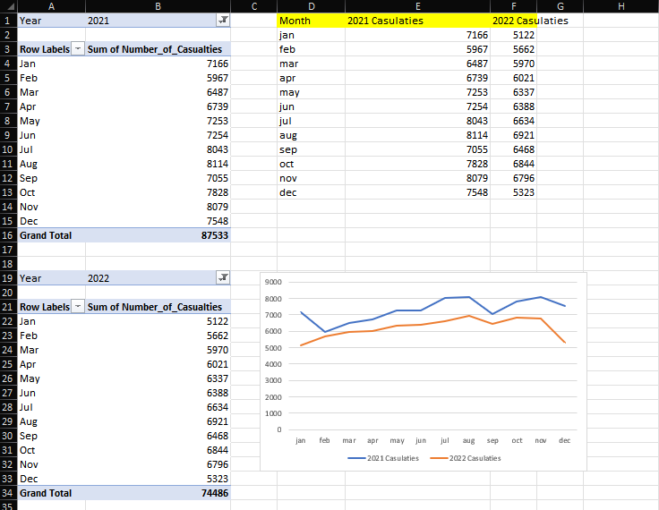
Data analysis

Slide 12
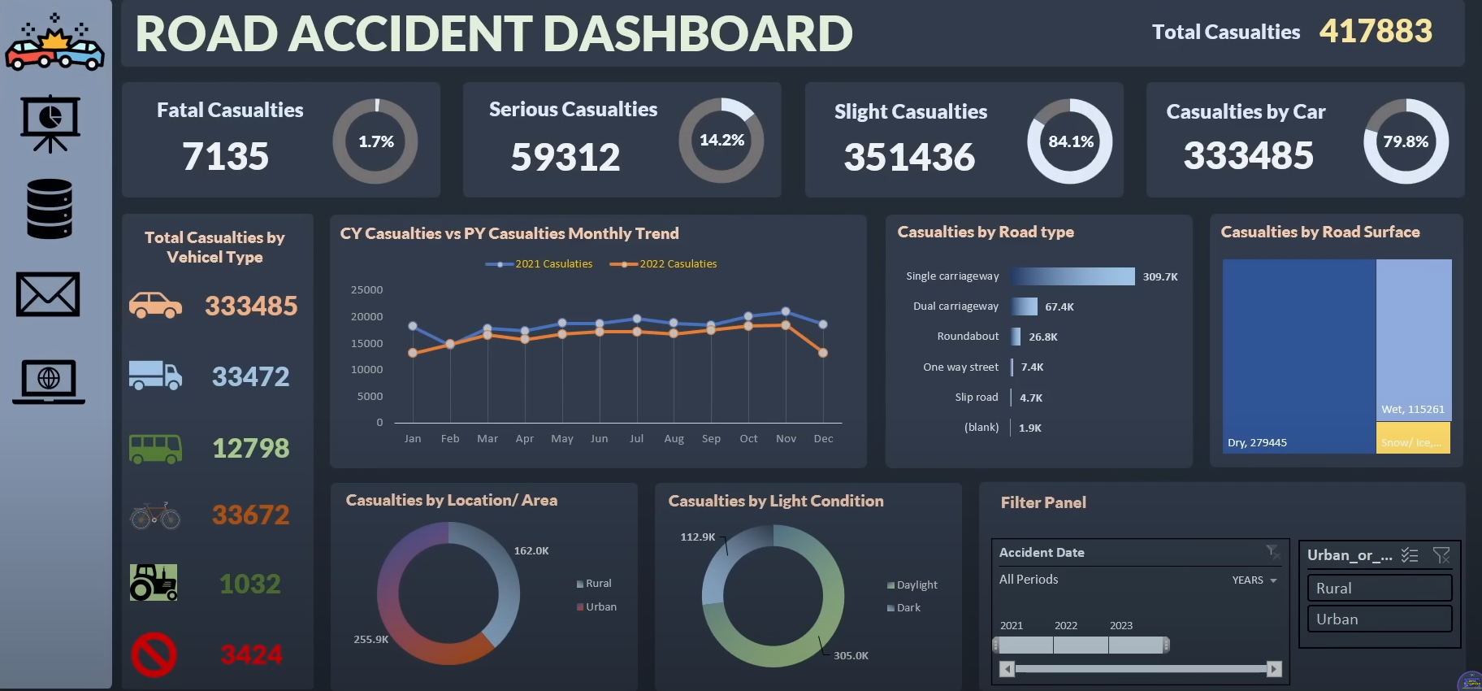
Dash board

